Slide 1

Design of Reinforced Earth Retaining Wall
A. Raj Kumar – 20335A0101
S. Sai Rakesh – 20335A0113
M. Devi Prasanna – 19331A0161
V. Abhishek – 19331A0194
Under the guidance of
Mr. B. Ramu
Assistant professor
Department of Civil Engineering
MVGR College of Engineering (A), Vizianagaram

Slide 2
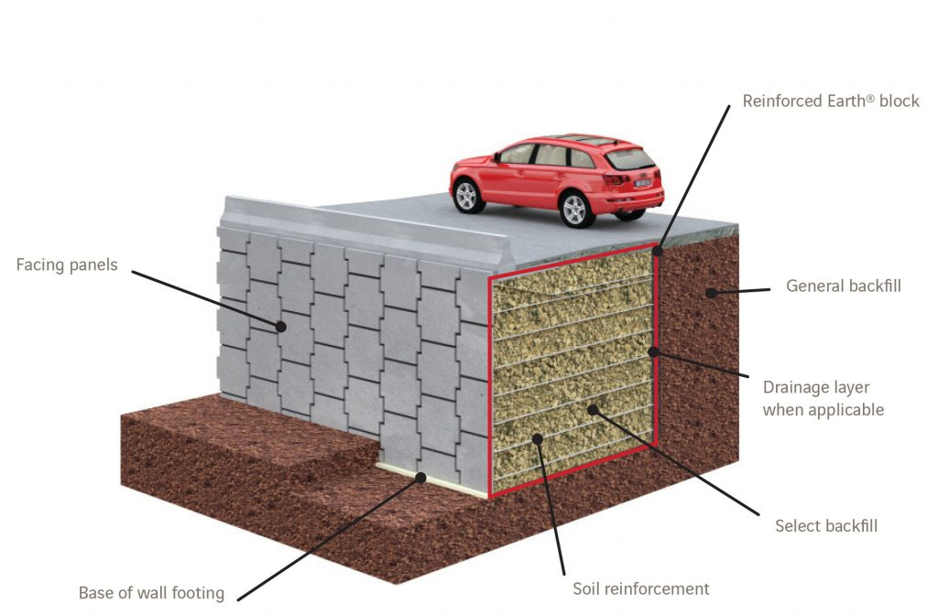
INTRODUCTION
A retaining wall is a structure that retains soil & prevents it from sliding/eroding away.
RE wall is a composite structure consisting of alternate layers of compacted backfill and soil reinforcement elements, fixed to a wall facing.
The stability of the wall system is derived from the interaction between the backfill and soil reinforcements.
Reinforcement placed in horizontal layers throughout the height of the wall provides the tensile strength to hold the soil together.
Components of RE wall :-
1. Subgrade or foundation soil.
2. Levelling pad.
3. Backfill.
4. Facing Elements.
5. Reinforcement
Fig.1.1 Reinforced earth retaining wall

Slide 3

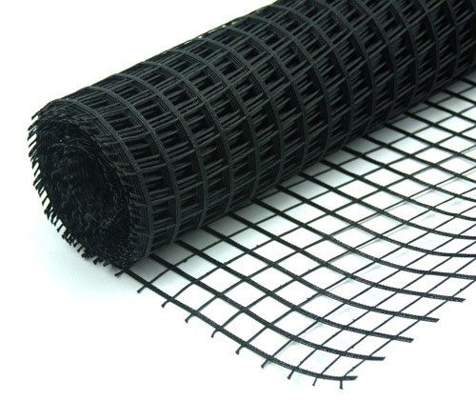
Advantages of Reinforced earth retaining wall :-
1. High load carrying capacity.
2. Fast track constructions.
3. Long term durability.
4. Cost effective.
5. Aesthetic appearance.
6. Good Drainage condition.
Fig.1.2 RE wall in highway roads
Geogrid: It is the major geosynthetic material made from polymers such as polyethylene or polyester, formed by means of intersecting grids, used to reinforce soils.
About the programming language :-
Fig.1.3 Geogrid
Python is a high-level, interpreted programming language that is widely used for a variety of applications such as web development, scientific computing, data analysis, artificial intelligence, and automation.
The use of Python can help reduce the potential for human error, increase efficiency, and improve the overall accuracy of the design process.

Slide 4
LITERATURE REVIEW
J.B. Kennedy (1980): This paper is studied on analysis to estimate the maximum tensile force in the rein-forcing elements when the reinforced earth retaining wall was subjected to a vertical surcharge strip load.
J.T. Laba (1984): This is studied on structural response of a reinforced earth retaining wall model subjected to the combined action of vertical and horizontal surcharge strip loads aligned parallel to the wall head.
IRC-SP:102-(2014): The document covered various aspects of reinforced soil walls, including types of reinforcement, types of facing systems, design methodologies, construction practices, and quality control measures.
Izzaldin Almohd (2014): The paper explained about internal stability which is examined by satisfying the local stability of reinforcements at each level based on the predetermined critical slip plane (line of maximums) and the tributary area of each reinforcing layer.

Slide 5
“ DESIGN OF REINFORCED EARTH RETAINING WALL USING PYTHON CODE ”
PROBLEM STATEMENT
OBJECTIVES
To study and analyse the internal and external stability conditions of retaining wall.
To develop Python code for design of reinforced earth retaining wall as per IS 8006-2010.
SCOPE OF THE PROJECT
The scope of the project involves designing and analysing a reinforced earth retaining wall for dry cohesionless backfill condition.
The design will consider dead load, live load, horizontal line load, and vertical line load conditions according to the BS 8000:2006 code of practice.
The aim is to provide an automated and reliable solution for designing a stable retaining wall that meets the specified requirements and loading conditions.

Slide 6
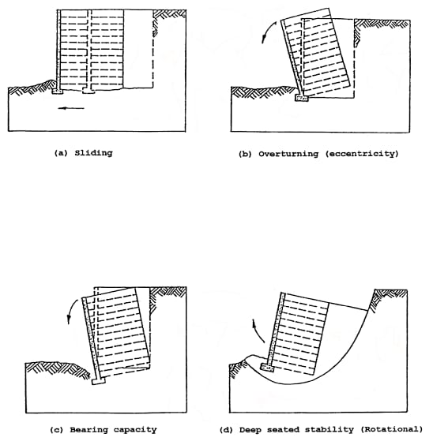
METHODOLOGY
The design procedures are laid on BS 8006-1:2010 (code of practice for strengthened
/reinforced soil and other fills).
Based on this the design RE wall is done.
The reinforced soil structure must be checked
with respect to :
External Stability.
Internal Stability.
External stability governs reinforced length and must have adequate safety against
Outward sliding.
Overturning.
Bearing failure.
Limiting eccentricity.
Fig.1.4 External failure modes of RE wall

Slide 7
Sliding occurs when the retaining wall is unable to resist the lateral forces acting on it.
FOS = Resisting force / Sliding force
= μ(γ_{γ}HL+q_{d}L) / (K_{a}q_{d}H+K_{a}q_{L}H+K_{a}γ_{b}H²/2) – (Dead load+Live load condition)
= μ[(γ_{γ}HL+q_{d}L)+V₁] / (K_{a}q_{d}H+K_{a}q_{L}H+K_{a}γ_{b}H²/2)+F₁ – (Dead load+Live load+ Horizontal & Vertical line loads condition)
A minimum value of 1.5 is specified.
Overturning occurs when the moments generated by the lateral forces acting on the wall cause it to rotate about its base.
FOS = Resisting moment / Sliding overturning moment
= γ_{γ}HL(L/2)+q_{d}L(L/2) / (K_{a}q_{d}H²/2+K_{a}q_{L}H²/2+0.5K_{a}γ_{b}H³/3) – (Dead load+Live load condition)
= γ_{γ}HL(L/2)+q_{d}L(L/2)+V₁d / (K_{a}q_{d}H²/2+K_{a}q_{L}H²/2+0.5K_{a}γ_{b}H³/3+F₁H) – (Dead load+Live load+Horizontal & Vertical line loads condition)
A minimum value of 2 is specified.

Slide 8
Bearing failure happens when the soil beneath the retaining wall's foundation is unable to support the applied loads.
Allowable bearing pressure = Resisting force / (L-2e)
= γ_{γ}HL+q_{d}L+q_{L}L) / (L-2e) – (Dead load+Live load condition)
= (γ_{γ}HL+q_{d}L+q_{L}L+V₁) / (L-2e) – (Dead load+Live load+Horizontal & Vertical line loads condition)
Allowable bearing pressure should be less than bearing capacity of soil.
Where ‘e’ is the eccentricity given by
e = (L/2) – [(M_{R}-M_{O}) / (γ_{γ}HL+q_{d}L)] – (Dead load+Live load condition)
e = (L/2) – [(M_{R}-M_{O}) / (γ_{γ}HL+q_{d}L+V₁)] – (Dead load+Live load+Horizontal & Vertical line loads condition)
Eccentricity should be less than or equal to L/6.

Slide 9
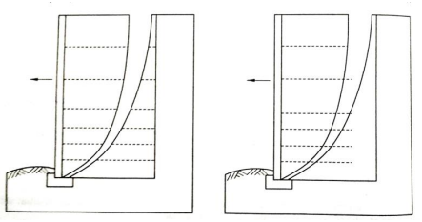
Internal stability governs reinforced spacing & must have adequate wedge stability for tension & pullout resistance.
Each layer is assumed to carry the local horizontal stresses, acting over an area equal to half the vertical spacing on either side of the layer per meter run of the wall.
Fig.1.5 Internal failure modes of RE wall
Tension failure will occur if the reinforcement strength is insufficient to carry the horizontal loads.
For wedge height ‘h’
1. Vertical stress (σv) is given by,
a. σv = γ_{γ}h+q_{d}+q_{L} – (Dead load+Live load condition)
b. σv = γ_{γ}h+q_{d}+q_{L}+V₁/b – (Dead load+Live load + Horizontal & Vertical line loads condition)
2. Tension (T) is given by,
a. T = K_{a}σvS_{v} – (Dead load+Live load condition)
b. T = (K_{a}σv+σH)S_{v} – (Dead load+Live load+Horizontal & Vertical line loads condition)
3. Factor of safety against rupture is given by,
a. Fos = T_{D}/T

Slide 10
Pullout failure occurs when the anchor or pile is subjected to a pulling force that exceeds its capacity to resist the force.
For wedge height ‘h’
1. Vertical stress (σv_{j}) is given by,
a. σv_{j} = γ_{γ}h_{j}+q_{d} – (Dead load+Live load condition)
b. σv_{j} = γ_{γ}h_{j}+q_{d}+V₁ – (Dead load+Live load+Horizontal & Vertical line loads condition)
2. Pullout resistance (P) is given by,
P = 2L_{ej}C_{fg}σv_{j}C_{i}αtanϕ
Where, L_{ej} = L-(h_{i}tanθ)
θ = 90-(45+φ/2)
C_{fg} = 1 ; C_{i} = 0.85
3. Factor of safety against pullout resistance is given by,
a. Fos = P/T

Slide 11
Case 1 : Dead load + Live load condition | Case 2 : Dead load + Live load + Horizontal & Vertical line load condition
Input parameters include, a. Angle of internal friction (ɸ) b. Density of backfill (γ) in KN/m³ c. Reinforcement length of wall (L) in m d. Height of Retaining wall (H) in m e. Dead load due to surcharge (qd) in KN/m² f. Live load (qL) in KN/m² g. Safe bearing capacity of soil in KN/m² | Input parameters include, a. Angle of internal friction (ɸ) b. Density of backfill (γ) in KN/m³ c. Reinforcement length of wall (L) in m d. Height of Retaining wall (H) in m e. Dead load due to surcharge (qd) in KN/m² f. Live load (qL) in KN/m² g. Horizontal line Load (F1) in KN/m h. Vertical line Load (V1) in KN/m i. Width of Strip (m) j. Distance of wall to centre of strip (m) k. Safe bearing capacity of soil in KN/m²
Output include, a. Length of reinforcement. b. Spacing of reinforcement at each layer. c. Grading of reinforcement at each layer.

Slide 12
RESULTS & DISCUSSION
Python code : Case 1 - Dead load+Live load condition :
#Inputting required parameters
import math
pi= float((input("Enter angle of internal friction : ")))
Vb = float((input("Enter Density of backfill (Kn/m3) : ")))
L = float((input("Enter Reinforcement length of wall (m) : ")))
H = float((input("Enter Height of Retaining wall (m) : ")))
Qd = float((input("Enter Dead load due to surcharge (Kn/m2) : ")))
Ql = float((input("Enter Live load (Kn/m2) : ")))
sbc = float((input("Enter Safe bearing capacity of soil (Kn/m2) : ")))
mue = 0.9*(math.tan(math.radians(pi)))
teta = 90-((45)+(pi/2))
Cfg = 1
Ci = 0.85
alpa = 0.8
ka = (1 - math.sin(math.radians(pi)))/(1 + math.sin(math.radians(pi)))
print("Coefficient of active earth pressure is", ka)
print("DESIGN OF RE RETAINING WALL : DEAD+LIVE LOAD")
print("EXTERNAL STABILITY CHECKS")
#Factor of safety against Sliding
Pv1 = Vb*H*L
Pv2 = Qd*L
Rf1 = Pv1+Pv2
Rh = ((ka*Qd*H)+(ka*Ql*H)+(0.5*ka*Vb*H*H))
Fos1 = (mue*Rf1)/Rh
print("Factor of safety against sliding is", Fos1)
if Fos1>1.5:
print("Fos>1.5, Hence Safe against sliding")
else :
print("Not Safe against sliding")
#Factor of safety against Overturning
Mr = (Pv1*(L/2)+Pv2*(L/2))
Mo = ((ka*Qd*0.5*H*H)+(ka*Ql*0.5*H*H)+(0.5*ka*Vb*H*H*H/3))
Fos2 = Mr/Mo
print("Factor of safety against Overturning is", Fos2)
if Fos2>2:
print("Fos>2, Hence Safe against overturning")
else :
print("Not Safe against overturning")
#Limiting Eccentricity
e = (L/2)-((Mr-Mo)/Rf1)
print("Eccentricity is", e)
if e<=(L/6):
print("e<L/6, Hence Safe against eccentricity")
else :
print("Not safe against eccentricity")
#Bearing Pressure
Qb = Rf1/(L-2*e)
print("Bearing Pressure is", Qb)
if Qb<sbc:
print("Qb<sbc, Hence Safe in Bearing")
else :
print("Not safe against bearing")

Slide 13
#Internal Stability checks
if Fos1>1.5 and Fos2>2 and e<=(L/6) and Qb<sbc:
print("INTERNAL STABILITY CHECKS")
#Factor of Safety against Rupture
print("FACTOR OF SAFETY AGAINST RUPTURE")
print("%-12s %-12s %-15s %-10s %-12s %-15s" %("Height (h)",
"Spacing(Sv)","Vertical Stress(V)","Tension(T)",
"Design Strength(Td)","FOS"))
h = 0.25
while h < H-0.25 :
if h == 0.25 :
Sv = 0.625
elif H-h <= 0.75 :
Sv = (0.75/2)+(H-h)
else :
Sv = 0.75
V = (Vb*h)+Qd+Ql
T = ka*V*Sv
Td = 20
Fos3 = Td/T
if Fos3>1.5 :
Td = 20
else :
Td = Td+20
Fos3 = Td/T
if Fos3<1.5 :
Td = Td+20
Fos3 = Td/T
if Fos3<1.5 :
Td = Td+20
Fos3 = Td/T
if Fos3<1.5 :
Td = Td+20
Fos3 = Td/T
print("%-15s %-15s %-15s %-15s %-10s %-10s" %('%.2f'%h,
'%.3f'%Sv,'%.2f'%V,'%.2f'%T,'%.f'%Td,'%.2f'%Fos3))
h = h+0.75
#Factor of Safety against Pull-out Resistance
print("FACTOR OF SAFETY AGAINST PULLOUT RESISTANCE")
print("%-8s %-10s %-8s %-6s %-20s %-16s %-20s" %("hi","Laj",
"Lej","hj","Vertical stress(Vj)","Pullout(P)","FOS"))
hi = H-0.25
hj = 0.25
h = 0.25
while hi>=0.375 and h <= H-0.25 :
Laj = math.tan(math.radians(teta))*hi
Lej = L-Laj
Vj = (hj*Vb)+Qd
P = 2*Lej*Cfg*Vj*Ci*alpa*math.tan(math.radians(pi))
if h == 0.25 :
Sv = 0.625
elif H-h <= 0.75 :
Sv = (0.75/2)+(H-h)
else :
Sv = 0.75
V = (Vb*h)+Qd+Ql
T = ka*V*Sv
Fos4 = P/T
print("%-8s %-10s %-8s %-13s %-16s %-13s %-16s" %
('%.3f'%hi,'%.3f'%Laj,'%.3f'%Lej,'%.2f'%hj,
'%.2f'%Vj,'%.2f'%P,'%.2f'%Fos4))
hi = hi-0.75
hj = hj+0.75
h = h+0.75
print("Hence safe against Rupture & Pullout Resistance")
print("Provide length of reinforcement:", L,"m")
print("Provide spacing of reinforcement: 0.625m at top layer",",",
Sv,"m at bottom layer and 0.75m at remaining layers with
appropriate grade of reinforcement as shown above")
else :
print("Hence not safe, increase length of reinforcement")

Slide 14
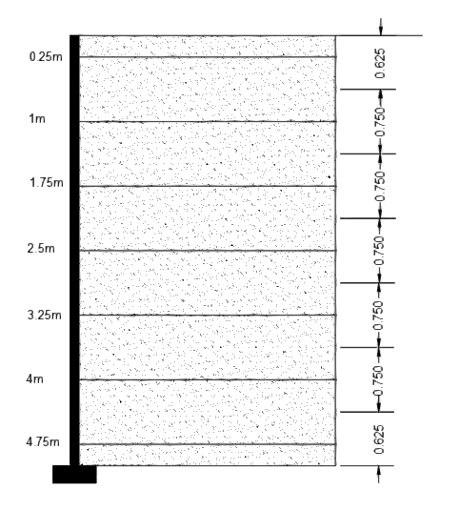
OUTPUT :
Enter angle of internal friction : 35
Enter Density of backfill (Kn/m3) : 20
Enter Reinforcement length of wall (m) : 6
Enter Height of Retaining wall (m) : 5
Enter Dead load due to surcharge (Kn/m2) : 15
Enter Live load (Kn/m2) : 20
Enter Safe bearing capacity of soil (Kn/m2) : 300
Coefficient of active earth pressure is 0.2709900
External Stability :
The factor of safety obtained is 3.775
The factor of safety against overturning is 8.942
Eccentricity is 0.335
The bearing pressure for the sample is 151.99 KN/m2
Internal Stability :
Height from top (h) | Spacing (Sv) in m | Design strength (TD) | Factor of safety
0.25 | 0.625 | 20 | 2.95>1.5
1.00 | 0.75 | 20 | 1.79>1.5
1.75 | 0.75 | 40 | 2.81>1.5
2.50 | 0.75 | 40 | 2.32>1.5
3.25 | 0.75 | 40 | 1.97>1.5
4.00 | 0.75 | 40 | 1.71>1.5
4.75 | 0.625 | 40 | 1.82>1.5
Fig.1.6 Spacing of reinforcement

Slide 15
Case 2 : Dead load+Live load+Horizontal & Vertical line load condition :
#Inputting required parameters
import math
pi= float((input("Enter angle of internal friction : ")))
Vb = float((input("Enter Density of backfill (Kn/m3) : ")))
L = float((input("Enter Reinforcement length of wall (m) : ")))
H = float((input("Enter Height of Retaining wall (m) : ")))
Qd = float((input("Enter Dead load due to surcharge (Kn/m2) : ")))
Ql = float((input("Enter Live load (Kn/m2) : ")))
F1 = float((input("Enter Horizontal line Load (KN/m) : ")))
V1 = float((input("Enter Vertical line Load (KN/m) : ")))
b = float((input("Enter Width of Strip (m) : ")))
d = float((input("Enter Distance of wall to centre of strip (m) : ")))
sbc = float((input("Enter Safe bearing capacity of soil (Kn/m2) : ")))
mue = 0.9*(math.tan(math.radians(pi)))
teta = 90-((45)+(pi/2))
Cfg = 1
Ci = 0.85
alpa = 0.8
ka = (1 - math.sin(math.radians(pi)))/(1 + math.sin(math.radians(pi)))
print("Coefficient of active earth pressure is", ka)
print("DESIGN OF RE RETAINING WALL : DEAD+LIVE LOAD+
HORIZONTAL & VERTICAL LINE LOAD CONDITION")
print("EXTERNAL STABILITY CHECKS")
#Factor of safety against Sliding
Pv1 = Vb*H*L
Pv2 = Qd*L
Pv3 = V1
Rf1 = Pv1+Pv2+Pv3
Rf = Pv1+Pv2+(Ql*L)+V1
Rh = ((ka*Qd*H)+(ka*Ql*H)+(0.5*ka*Vb*H*H))
Fos1 = (mue*(Rf1+V1))/(Rh+F1)
print("Factor of safety against sliding is", Fos1)
if Fos1>1.5:
print("Fos>1.5, Hence Safe against sliding")
else :
print("Not Safe against sliding")
#Factor of safety against Overturning
Mr = (Pv1*(L/2)+Pv2*(L/2)+V1*d)
Mo = ((ka*Qd*0.5*H*H)+(ka*Ql*0.5*H*H)+
(0.5*ka*Vb*H*H*H/3) +(F1*H))
Fos2 = Mr/Mo
print("Factor of safety against Overturning is", Fos2)
if Fos2>2:
print("Fos>2, Hence Safe against overturning")
else :
print("Not Safe against overturning")

Slide 16
#Bearing Pressure
Qb = Rf/(L-2*e)
print("Bearing Pressure is", Qb)
if Qb<sbc:
print("Qb<sbc, Hence Safe in Bearing")
else :
print("Not safe against bearing")
b1 = b+(4*h)
if b1 < L :
b1 = b1
else :
b1 = L
if h < L1 :
Hl = Hmax*(L1-h)/L1
else :
Hl = 0
V = (Vb*h)+Qd+Ql+(V1/b1)
H1 = (ka*V)+Hl
T = H1*Sv
Td = 20
Fos3 = Td/T
if Fos3>1.5 :
Td = 20
else :
Td = Td+20
Fos3 = Td/T
if Fos3<1.5 :
Td = Td+20
Fos3 = Td/T
if Fos3<1.5 :
Td = Td+20
Fos3 = Td/T
if Fos3<1.5 :
Td = Td+20
Fos3 = Td/T
if Fos3<1.5 :
Td = Td+20
Fos3 = Td/T
if Fos3<1.5 :
Td = Td+20
Fos3 = Td/T
print("%-10s %-10s %-6s %-6s %-8s %-8s %-12s %-8s %-10s" %('%.2f'%h,'%.3f'%Sv,'%.1f'%Hl,'%.2f'%(V1/b1),
'%.2f'%V,'%.2f'%H1, '%.2f'%T,'%.f'%Td,'%.2f'%Fos3))
h = h+0.75
#Limiting Eccentricity
e = (L/2)-((Mr-Mo)/Rf1)
print("Eccentricity is", e)
if e<=(L/6):
print("e<L/6, Hence Safe against eccentricity")
else :
print("Not safe against eccentricity")
#Internal Stability checks
if Fos1>1.5 and Fos2>2 and e<=(L/6) and Qb<sbc:
print("INTERNAL STABILITY CHECKS")
#Factor of Safety against Rupture
print("%-9s %-9s %-4s %-4s %-9s %-9s %-7s %-7s %-7s" % ("Height(h)","Spacing(Sv)","𝜎H","V1/b","Stress(V)","
Stress(H)","Tension(T)","Strength(Td)","FOS"))
h = 0.25
while h <= H-0.25 :
if h == 0.25 :
Sv = 0.625
elif H-h <= 0.75 :
Sv = (0.75/2)+(H-h)
else :
Sv = 0.75

Slide 17
#Factor of Safety against Pull-out Resistance
print("FACTOR OF SAFETY AGAINST PULLOUT RESISTANCE")
print("%-8s %-10s %-8s %-6s %-20s %-20s %-20s" %("hi","Laj", "Lej","hj","Vertical stress(Vj)","Pullout(P)","FOS"))
hi = H-0.25
hj = 0.25
h = 0.25
while hi>=0.25 and h <= H-0.25 :
Laj = math.tan(math.radians(teta))*hi
Lej = L-Laj
Vj = (hj*Vb)+Qd
if h == 0.25 :
Sv = 0.625
elif H-h <= 0.75 :
Sv = (0.75/2)+(H-h)
else :
Sv = 0.75
V = (Vb*h)+Qd+Ql
b1 = b+(4*h)
if b1 < L :
b1 = b1
else :
b1 = L
if h < L1 :
Hl = Hmax*(L1-h)/L1
else :
Hl = 0
V = (Vb*h)+Qd+Ql+(V1/b1)
H1 = (ka*V)+Hl
T = H1*Sv
P = 2*Lej*Cfg*Vj*Ci*alpa*math.tan(math.radians(pi))
Fos4 = P/T
print("%-8s %-10s %-8s %-13s %-15s %-16s %-20s"
('%.3f'%hi,'%.3f'%Laj,'%.3f'%Lej,'%.2f'%hj,
'%.2f'%Vj,'%.2f'%P,'%.2f'%Fos4))
hi = hi-0.75
hj = hj+0.75
h = h+0.75
print("Hence safe against Rupture & Pullout Resistance")
print("Provide length of reinforcement:", L,"m")
print("Provide spacing of reinforcement: 0.625m at top layer",",",Sv,"m at bottom layer and 0.75m at remaining layers with appropriate grade of reinforcement
as shown above")
else :
print("Hence not safe, increase length of reinforcement")

Slide 18
CONCLUSION
In conclusion, our project successfully addressed the design of a reinforced earth retaining wall using Python code.
The code will take input parameters such as soil properties, wall geometry, loads such as dead load, live load, horizontal & vertical line loads acting on the retaining wall, and will output the reinforcement requirements ensuring factor of safety against rupture and pullout resistance.
This code can be adopted for dry cohesionless horizontal backfill for any height of retaining wall as per BS 8006-1:2010 (code of practice for strengthened /reinforced soil and other fills) for given below loading conditions,
Dead load+Live load condition.
Dead load+Live load+Horizontal & Vertical line load condition.

Slide 19
REFERENCES
The design procedures are lain on BS 8006-1:2010
(code of practice for strengthened/reinforced soil and other fills).
J.T. Laba and J.B. Kennedy (1986) ‘Reinforced earth retaining wall analysis and design’, Windsor, Ont., Canada N9B 3P4.
Lee, K.L., Admas, B. D., and Vagneron, J.J. (1973) ‘Reinforced earth retaining walls’, ASCE - Journal of the Soil Mechanics and Foundation Division, 99(SM10), pp. 745-
764.
Izzaldin Almohd (2014) ‘A Case Study of Efficient Solution for Very High Geogrid_x005F_x0002_Reinforced Retaining Wall’.
Dr. P. D. Hiwase (2018) ‘Adoption of Programming Codes in the Design of Earth
Retaining Wall in Different Backfill Conditions’ - The International Journal of
Engineering and Science (IJES).
IRC:SP:102- (2014) ‘Guidelines for design and construction of reinforced soil walls’.
G L Sivakumar Babu, An introduction to soil reinforcement and Geosynthetics.
Michael Dobie (2013) ‘Reinforced Soil Retaining Walls - An Outline of Design Methods and Sources of Conservatism’.
MORTH Standard Data Book.
AP SOR 2019-2020.

Slide 20


